Slide 1

SKILL ENHANCEMENT COURSE - IOT
IOT Automatic Street Light
Presented by
Ch.Narender 160724748103
Sufiya Maheen 160724748110
G.Vinodhini 160724748127
Department of Computer Science
(Artificial Intelligence and Machine Learning)
Under Guidance of
-Mr.Mujthaba Gulam Muqeeth
Associate Professor
Dept of Computer Science Engineering
-Mr.K.Murlidhar
Assistant professor

Slide 2
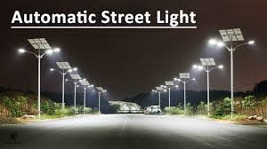
abstract
The project is about IOT-based automatic street light. The system turns light on at night and off in the day. sensors detect vehicles and peoples and adjust brightness accordingly. It uses IOT components like LDR ,IR sensors and micro controllers for automation. this helps save electricity, reduce human efforts, and improve road safety.
~ Useful in highways, smart cities, rural areas with limited power, campuses and residential streets.

Slide 3
Introduction
In modern cities, street lighting plays a major role in ensuring public safety and efficient transportation during nighttime.
However, traditional street lighting systems are mostly manually operated or depend on fixed timers.
This often leads to problems such as:
Lights staying ON during the daytime or in well-lit areas.
Human errors in switching lights ON or OFF.
Wastage of electricity and increased power bills.
Unnecessary maintenance and reduced system efficiency.
To overcome these drawbacks, an IoT-based automatic street lighting system is proposed.

Slide 4
Algorithm:
Step 1: Start the system.
Step 2: Initialize all LEDs, LDR sensor, and IR sensors.
Step 3: Read the LDR sensor value.
Step 4: If light intensity is high (daytime), turn OFF all LEDs.
Step 5: Else (nighttime):
  Continuously read IR sensors (A1–A5).
  If any IR sensor detects motion, turn ON nearby LEDs at full brightness.
  If no motion is detected, keep LEDs dim to save energy.
Step 6: Repeat the process continuously.
Output:
During daytime, all street lights remain OFF.
During night, LEDs turn ON automatically.
When a vehicle or person passes, nearby lights increase brightness.
After they pass, lights return to dim mode, saving energy.

Slide 5
1.
5.
Detect motion
Initialization
Check ambient light
2.
Increase brightness
6.
Iot street light
PICTORIAL REPRESENTATION
Wait for darkness
3.
Dim lights
7.
Turn on lights
loop
4.
8.

Slide 6
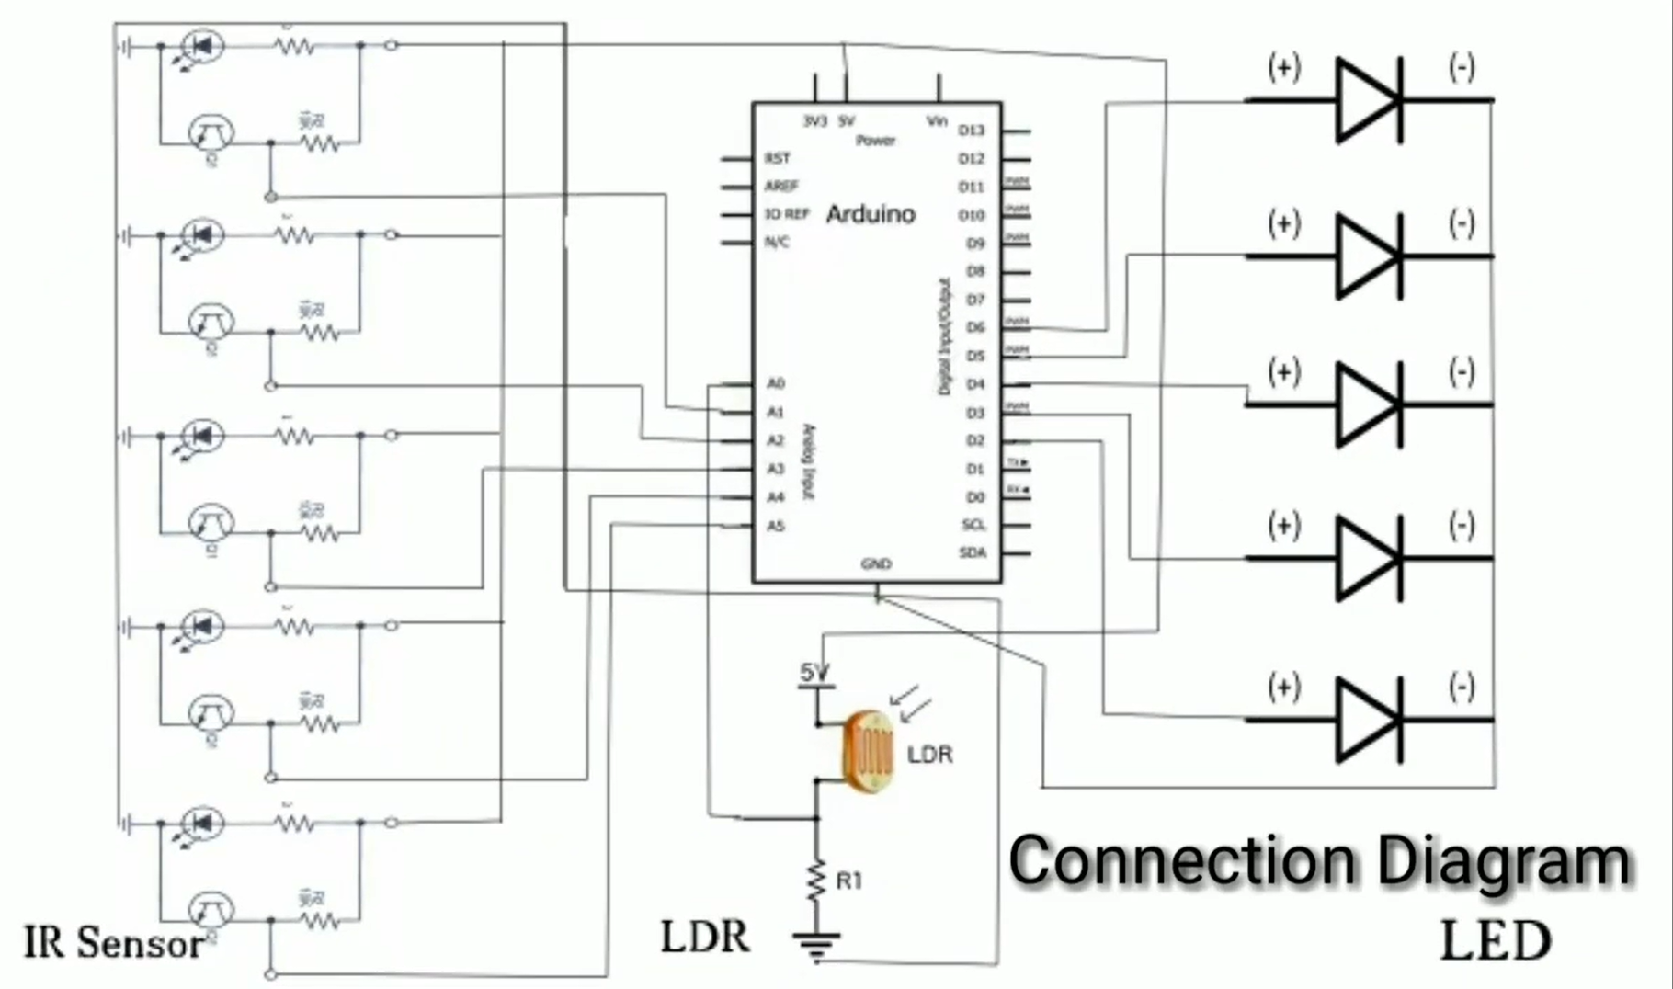
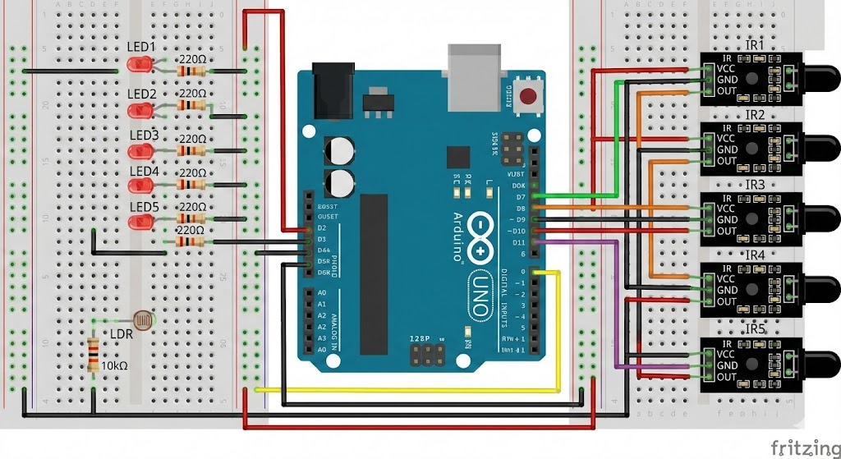

Slide 7
LITERATURE SURVEY
SL.NO | Book / Chapter Title | Author(s) | Publisher | Year
1 | IOT Based Smart Street Pole for Smart Cities | D. Betteena & S. Fernando | AIJR Books | 2020
2 | IOT Based Smart Street Lighting System | Prashanth S. U., Rakshanraj J. & A. Maria Christina Blessy | IJERT (ETEDM 2022 Conference) | 2022
3 | IOT Based Smart Street Light System – From Legacy to Intelligent: A Retrofit Approach | Gaurav Kumar Biswas & Hardik | IJERT | 2024
4 | Intelligent Street Lighting: An IoT-based System for Adaptive Brightness and Fault Management | S. Sasidevi & Vasanthi M. | IRO Journals | 2024

Slide 8
5. | IOT based Automatic Street Light Control | R. S. Carlos & Rumiasih Rumiasih | Atlantis Press (Proceedings) | 2024
6. | Smart Street Lighting System for Smart Cities Using IOT (LoRa) | C. V. Suresh Babu, R. Monika, T. Dhanush, K. Vishnuvaradhan | IGI Global (in book Effective AI, Block chain, and E-Governance Applications for Knowledge Discovery and Management) | 2023
7. | LDR and IR Based Automatic Street Light Controller | ------ | IIP Series (Volume 3, Book 3) | 2024
8. | IoT Based Smart Street Light | M. R. Rashmi & H. Padma | International Journal of Recent Advances in Multidisciplinary Topics | 2021
9. | Smart Automated Highway Lighting System using IoT: A Survey | (Not full book) | Energy Informatics / SpringerOpen | 2024
10 | IoT Based Street Light Auto Intensity Control and Fault Detection | Sampath Kumar Pappula & Lakshmi Lavanya Eemani | JERT | 2022

Slide 9
PROBLEM STATEMENT
The cost of IOT devices and setup is high compared to normal lights.
Sensors and devices need regular maintenance for proper working.
The whole system depends on a stable internet connection.
Power cuts or fluctuations can affect its performance.
Handling and analysing large amounts of data is difficult.
Communication range is limited in some IOT networks.
Sensors may get damaged due to dust, rain, or weather conditions.
Connecting IOT systems with old lighting systems is hard.
Faults in lights or sensors are not detected immediately.

Slide 10
Proposed Solutions for Smart Street Light Systems
Use LDR sensors to detect daylight and switch lights OFF when there is enough natural light.
Lights automatically turn ON at night or in low-light conditions.
Use IR or motion sensors to detect vehicles or people and turn lights ON only when needed.
The whole system can be remotely monitored and controlled through an IoT platform.
This helps save electricity, reduce maintenance costs, and improve road safety.

Slide 11
FUTURE SCOPE
Smart city street lighting
Highways and expressways
Rural and remote roads
Parking lots and campuses
Industrial zones and warehouses
Residential colonies and housing societies
Parks, footpaths, and public spaces
Smart transportation systems
Airport runways and railway platforms

Slide 12
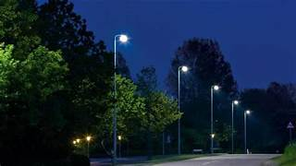
Conclusion
The IoT-based street light auto-adjusts brightness using sensors, turning ON at night, OFF by day, to save energy and improve safety.
This technology enhances urban efficiency by providing optimal lighting when needed, reducing electricity costs and extending the lifespan of the lights.

Slide 13
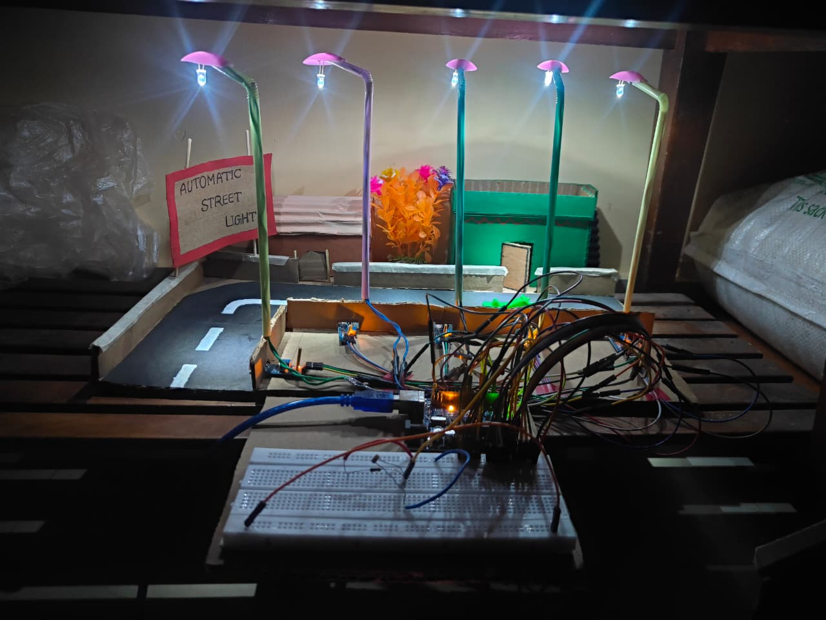
Result :

Slide 14

Reference
(Youtube link)
https://youtu.be/Zn8MMA2-Opw?si=J1SXnGE5jRbFM34h
1pcs LDR - https://amzn.to/2BUKY8B
5pcs IR Sensors - https://amzn.to/2GJoU4Z
1pcs Arduino Uno - https://amzn.to/3vpGW2z
components

Slide 15


Slide 16
Thank you..

